Slide 1
Interfacing of Temperature sensor and fan with BBBW
Submitted by
Ashok Kumar Saini

Slide 2
Objectives
Introduction
Requirement
LM35 Temperature Sensor
Optocoupler Working
Coding
Output
Reference

Slide 3
Introduction
Our Project is about Smart Restaurant Ordering Menu
Use of temp sensor to sense temperature (kitchen)
If Temperature is above a threshold then Switch ON the Fan
Fan is Isolated from BBBW through Octocoupler

Slide 4
Requirement
LM35 Temperature Sensor
MCT2E Optocoupler
Jumper Wires
DC fan
Beagle Bone Black Wireless
A PC/Laptop

Slide 5
Temperature Sensor
LM35 is a precession Integrated circuit Temperature sensor, whose output voltage varies, based on the temperature around it. It is a small and cheap IC which can be used to measure temperature anywhere between -55°C to 150°C.
It can easily be interfaced with any Microcontroller that has ADC function or any development platform like Arduino.

Slide 6
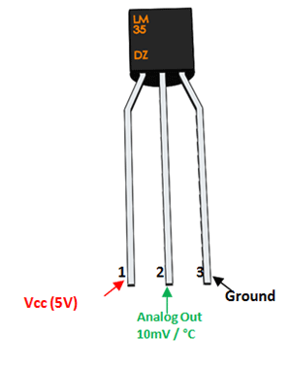
Temperature Sensor
Power the IC by applying a regulated voltage like +5V (VS) to the input pin and connected the ground pin to the ground of the circuit.
If the temperature is 0°C, then the output voltage will also be 0V. There will be rise of 0.01V (10mV) for every degree Celsius rise in temperature.

Slide 7
Features of Temperature Sensor
LM35 Regulator Features:
Minimum and Maximum Input Voltage is 35V and -2V respectively. Typically 5V.
Can measure temperature ranging from -55°C to 150°C
Output voltage is directly proportional (Linear) to temperature (i.e.) there will be a rise of 10mV (0.01V) for every 1°C rise in temperature.
±0.5°C Accuracy
Drain current is less than 60uA
Low cost temperature sensor
Small and hence suitable for remote applications

Slide 8
Pin Configuration
Pin Number | Pin Name | Description
1 | Vcc | Input voltage is +5V for typical applications
2 | Analog Out | There will be increase in 10mV for raise of every 1°C. Can range from -1V(-55°C) to 6V(150°C)
3 | Ground | Connected to ground of circuit

Slide 9
Calculation of Temperature
Step size of LM 35 is 10 mV means when 1 degree temperature changes, output voltage of sensor increases by 10 mV.
Step size of ADC is 0.44 mV that’s why we need to divide it by 22.75 to get the correct temperature in Celsius.
Factor value = 10 mV / 0.44 mV = 22.75 mV
Dout = (Vin * 4096) / 1800
Celsius = (Dout)/22.75

Slide 10

Connecting LM35 to BBBW
Pin
Pin 1 of (vcc) of LM35 to pin 4 of P9 header of BBBW.
Pin
Pin 2 of (analog Output) of LM35 to pin 40 of P9 header of BBBW.
Pin
Pin 3 of (GND) of Lm35 to pin 45 or 46 of P9 header of BBBW.

Slide 11
MCT2E Optocoupler
MCT2E is a phototransistor Optocoupler, as the name “phototransistor” suggests it has a transistor which is controlled based on light (photon).
this IC basically has an IR (infrared) LED and a photo-transistor inside it. When the IR led is powered the light from it falls on the transistor and it conducts.

Slide 12
MCT2E pin Configuration
Pin Number | Pin Name | Description
1 | Anode (A) | Anode pin of the IR LED. Connected to logic input
2 | Cathode (C) | Cathode pin of the IR LED
3 | NC | Cannot be used
4 | Emitter (E) | Emitter pin of the Transistor. Connected to isolated ground.
5 | Collector (C) | Collector pin of the Transistor. This is the logic output pin
6 | Base (B) | Base pin of the Transistor. It is normally not used for transistor mode, but will be used in diode mode

Slide 13
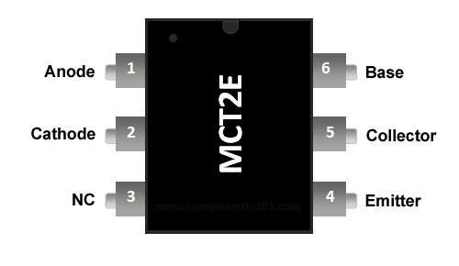
MCT2E Optocoupler
This IC is used to provide electrical isolation between two circuits, one part of the circuit is connected to the IR LED and the other to Photo-transistor.

Slide 14


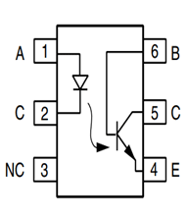

MCT2E Optocoupler
z
The digital signal given to the IR LED will be reflected on the transistor but there will be no hard electrical connection between the two.

Slide 15
Working of MCT2E
when the Logic input is low the IR LED will not conduct and hence the transistor will also be in off state.
The Logic input is made high, this high voltage should be a minimum of 1.25V (Diode Forward voltage) the IR LED conducts and so the photo-transistor is also turned on. This will short the collector and emitter and hence the Logic Output voltage will become zero. This way the logic input will be reflected at the logic output and still provides and isolation between the two.

Slide 16
MCT2E Optocoupler specification
Input Diode Forward Voltage: 1.25V
Collector-Emitter Voltage: 30V
On-State Collector Current: 5mA
Transistor HFE: 300
Rise Time: 5us
Fall Time: 5us
Available as 6-pin PDIP with and without M-suffix

Slide 17
Connection with BBBW
Pin no 1 of MCT2E with gpio_67 pin 8 of P8 header of Beagle bone black wireless.
Pin no 2 of MCT2E with DGND pin 1/2 of P9 header of Beagle bone black wireless.
Pin no 4 of MCT2E with GND of Breadboard
Pin no 5 of MCT2E with positive (red wire) of DC fan.

Slide 18

DC fan
Fan Size: 120x120x25mm
RPM: 3000 +/- 10%
Rated Current: 0.36 Amp Running / 0.6 Amp Startup
Airflow: 105 CFM
Noise: 42 dB
Rated Voltage: 12 V DC
Bearing Type: Ball Bearing

Slide 19
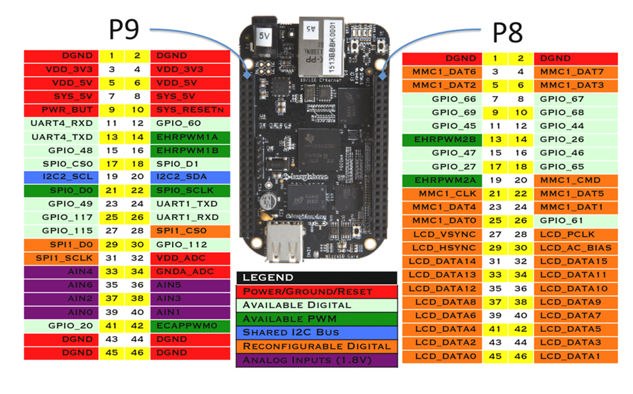
Pin configuration for BBBW

Slide 20
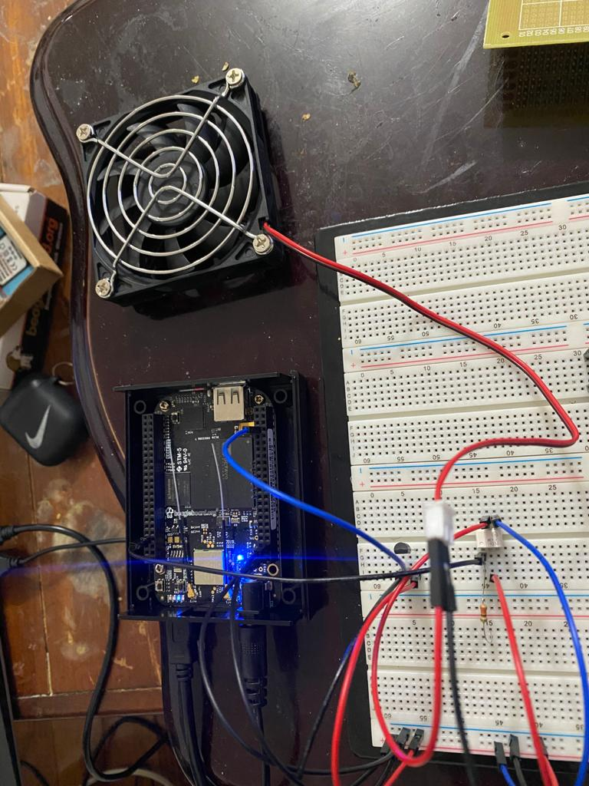

Slide 21
Code
include<iostream> //This header file contains all the functions of program like cout, cin etc.
#include<cstring> //This header file declares a set of functions to work with C style string.
#include<unistd.h> // This header file is for miscellaneous functions declaration.
#include "buzzer.h" //It contains buzzer function.
#define LOW 0
#define HIGH 1
using namespace std;

Slide 22
Code
int pin_number=67; //This is a GPIO_67 of Beaglebone Black Wireless
int getTemp() // generating a temerture function
{
float calculated_temp; // generating a local variable
fstream f; // generating a stream for file
f.open("/sys/bus/iio/devices/iio:device0/in_voltage1_raw"); // config P9_40 AIN of BBBW
f>>calculated_temp; // giving file address to local variable
calculated_temp= (calculated_temp/22.75); // formula for calculating temp in celsius
return (int)calculated_temp; //returning integer value to getTemp function
}

Slide 23
Code
int main()
{ while(1)
{
if (getTemp()>= 15 ) {
pinSetup(pin_number,"out"); //Setting GPIO_67 as output.
output(pin_number,HIGH); //Sending high (1) logic to GPIO_67.
cout<<"fan is ON"<<endl;
system("sleep 1");
} else {
pinSetup(pin_number,"out"); //Setting GPIO_67 as output.
output(pin_number,LOW); //Sending Low(0) logic to GPIO_67
cout<<"fan is OFF"<<endl;
system("sleep 1");
}
} return 0; }

Slide 24
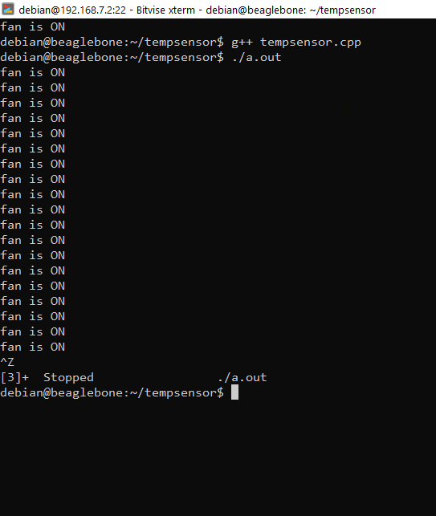
output
z

Slide 25
Reference
MCT2E information
https://components101.com/ics/mct2e-phototransistor-optocoupler-ic
LM35 Temperature sensor
https://components101.com/sensors/lm35-temperature-sensor#:~:text=LM35%20is%20a%20precession%20Integrated,C%20to%20150%C2%B0C.&text=There%20will%20be%20rise%20of,degree%20Celsius%20rise%20in%20temperature.

Slide 26
Referencei
Connecting with BBBW
http://exploringbeaglebone.com/chapter6/

Slide 27
Questions ?
z

Slide 28
Thanks !
z

